Slide 1

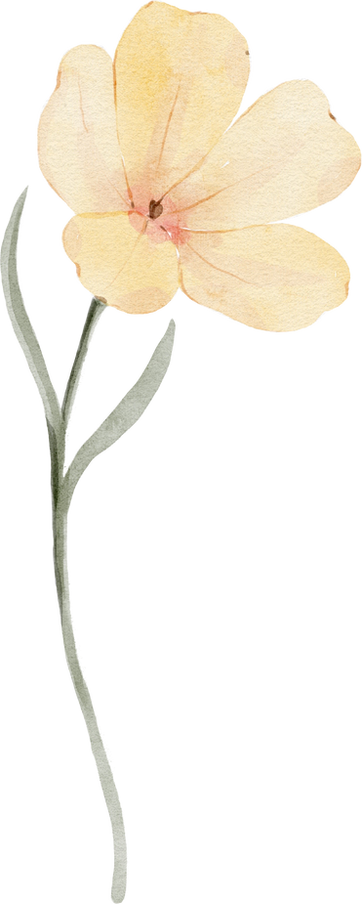


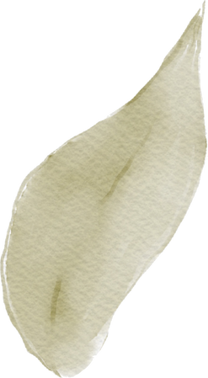
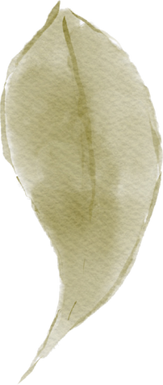

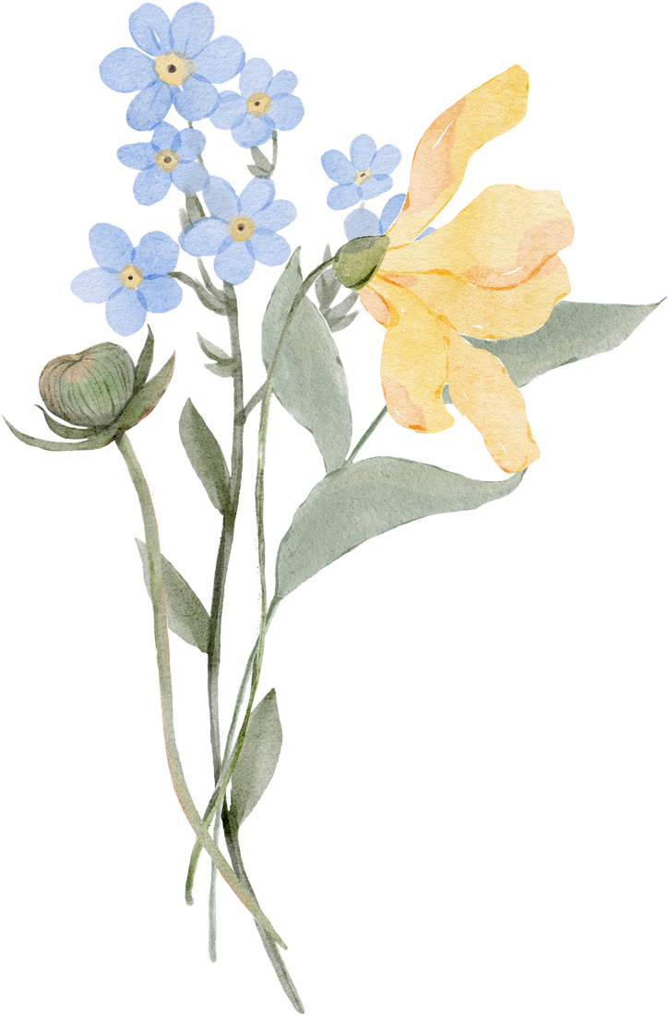


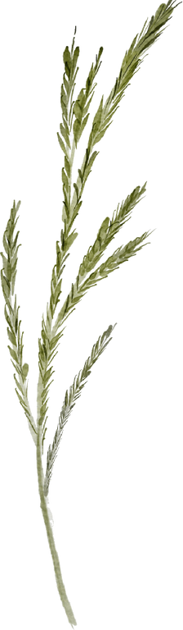

Floward System
By Renad Almana

Slide 2

Problem Statement
The lack of flower shops near my neighborhood.

Slide 3
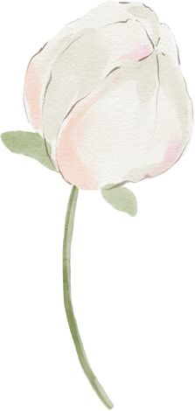

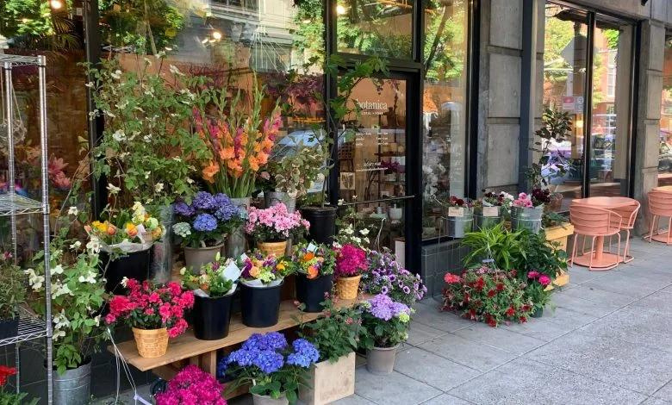

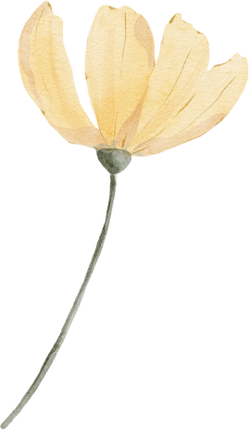
Description of the problem
There are few big stores that offer different and multiple types of flowers in my neighborhood, which causes a waste of time searching for, and reaching them in Riyadh, especially for people who buy flowers every week like me. So That's why I created a website to make ordering flowers easier.

Slide 4
Change user password.
Get non active users.
The
Solution
Update status.
Get orders by status.
Get product rate.

Slide 5
Thank You

